Slide 1
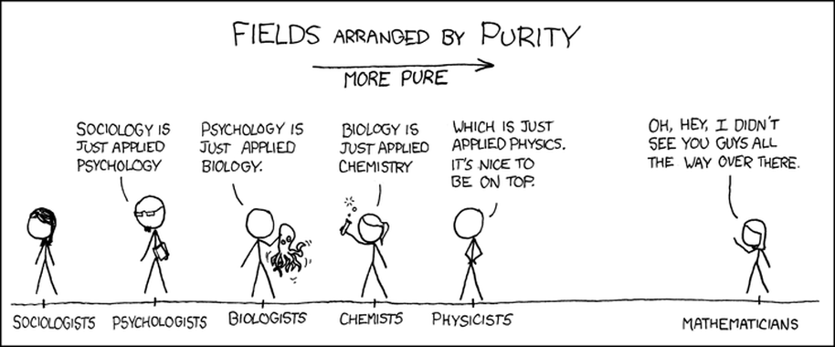
Numbers: What are they good for?
http://blog.forwardmapworks.com/

Slide 2
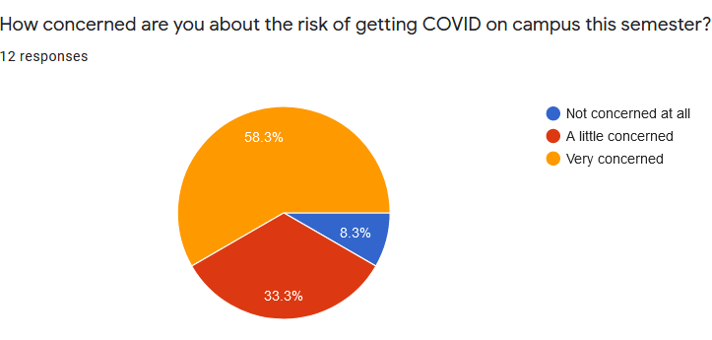
Your thoughts on COVID and this semester
http://blog.forwardmapworks.com/

Slide 3
Your thoughts on COVID and this semester
I’m excited for the educational benefits of being in-person but worried that I will inevitably get sick and have to miss one or more weeks of class.
I am both excited about being back in person and concerned about being around so many people. I understand that masks and vaccines cannot be mandated, but the fact that so many will be either unvaccinated and/or unmasked is a constant concern.
I'm looking forward to in-person since I prefer it much more than virtual, but I'm not sure how conscious or caring others are about taking the necessary precautions to stay in-person. It would be great if things got better, but with different points of view people have on COVID, it could get worse, and we could end up back online :(
I really enjoy in person classes. I am hopeful that as more people get vaccinated the likelihood of getting covid from class will significantly decrease. I do hope that individuals will continue wearing their masks while in class.
http://blog.forwardmapworks.com/

Slide 4
What, if anything, could we do as a class that would help you feel safer while in the classroom?
Encouragement of students to wear masks and social distance, just taking caution in general to help protect everyone.
It would be really relieving if everyone in the class would be wearing masks (I understand it cannot be enforced)
I think the class room is set up perfectly.
Hopefully those who do not want to wear masks indoors will keep in one general area. I did enjoy that the vast majority of the class had masks on last week. I am vaccinated, so I feel more comfortable than if I weren't.
http://blog.forwardmapworks.com/

Slide 5
What are the main strengths of quantitative research/statistics?
http://blog.forwardmapworks.com/

Slide 6
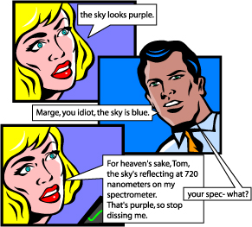
Arguments for quantification
Objectivity
Notes:
Why use quantitative data?

Slide 7
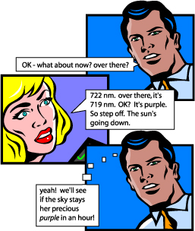
Arguments for quantification
Objectivity
Replication
Notes:
Why use quantitative data?
it allows us to repeat experiments in different times or different places
to discover patterns, regularities, trends…

Slide 8
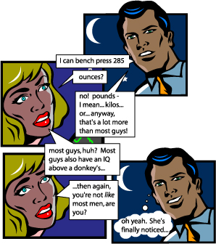
Arguments for quantification
Objectivity
Replication
Comparison
Notes:
Why use quantitative data?
It allows us to compare across places and times.

Slide 9
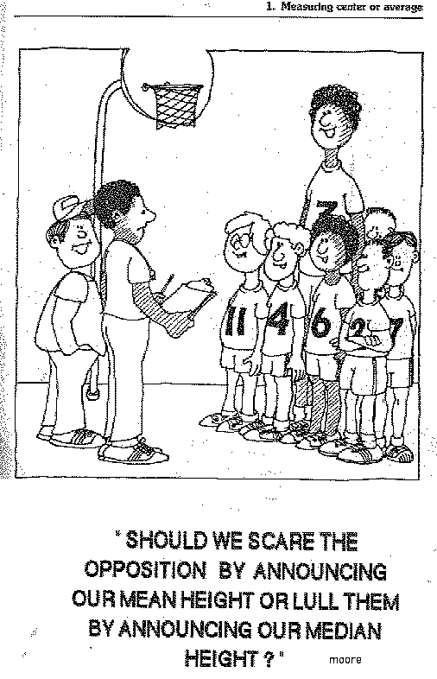
Arguments for quantification
Objectivity
Replication
Comparison
Aggregation
Notes:
It provides systematic ways to deal with outliers and see larger tendencies within the data.
Ex.—in the mid-80s, the average salary of a geography grad from UNC was something like $250,000. Why?

Slide 10
What are the weaknesses of quantitative methods?
Notes:
It provides systematic ways to deal with outliers and see larger tendencies within the data.
Ex.—in the mid-80s, the average salary of a geography grad from UNC was something like $250,000. Why?

Slide 11
Weaknesses of quantitative methods
Illusion of objectivity?
Abstraction from everyday experience
Necessity of calculable categories (e.g., racial classification)
A focus on associations rather than
underlying mechanisms
Notes:
It provides systematic ways to deal with outliers and see larger tendencies within the data.
Ex.—in the mid-80s, the average salary of a geography grad from UNC was something like $250,000. Why?

Slide 12

“Because most map users willingly tolerate white lies on maps, it's not difficult for maps also to tell more serious lies. Map users generally are a trusting lot: they understand the need to distort geometry and suppress features, and they believe the cartographer really does know where to draw the line, figuratively as well as literally. As with many things beyond their full understanding, they readily entrust mapmaking to a priesthood of technically competent designers and drafters working for government agencies and commercial firms. Yet cartographers are not licensed, and many mapmakers competent in commercial art or the use of computer workstations have never studied cartography. Map users seldom, if ever, question these authorities, and they often fail to appreciate the map's power as a tool of deliberate falsification or subtle propaganda.”
Notes:
It provides systematic ways to deal with outliers and see larger tendencies within the data.
Ex.—in the mid-80s, the average salary of a geography grad from UNC was something like $250,000. Why?

Slide 13
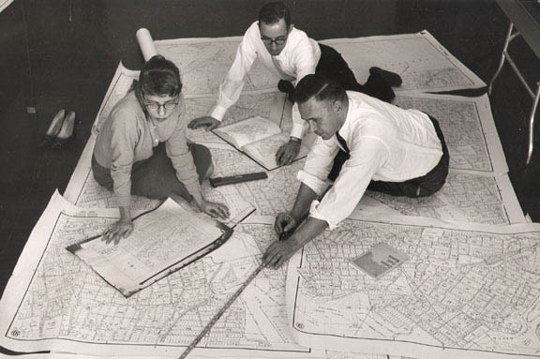
Statistics in Geography
http://blog.forwardmapworks.com/

Slide 14
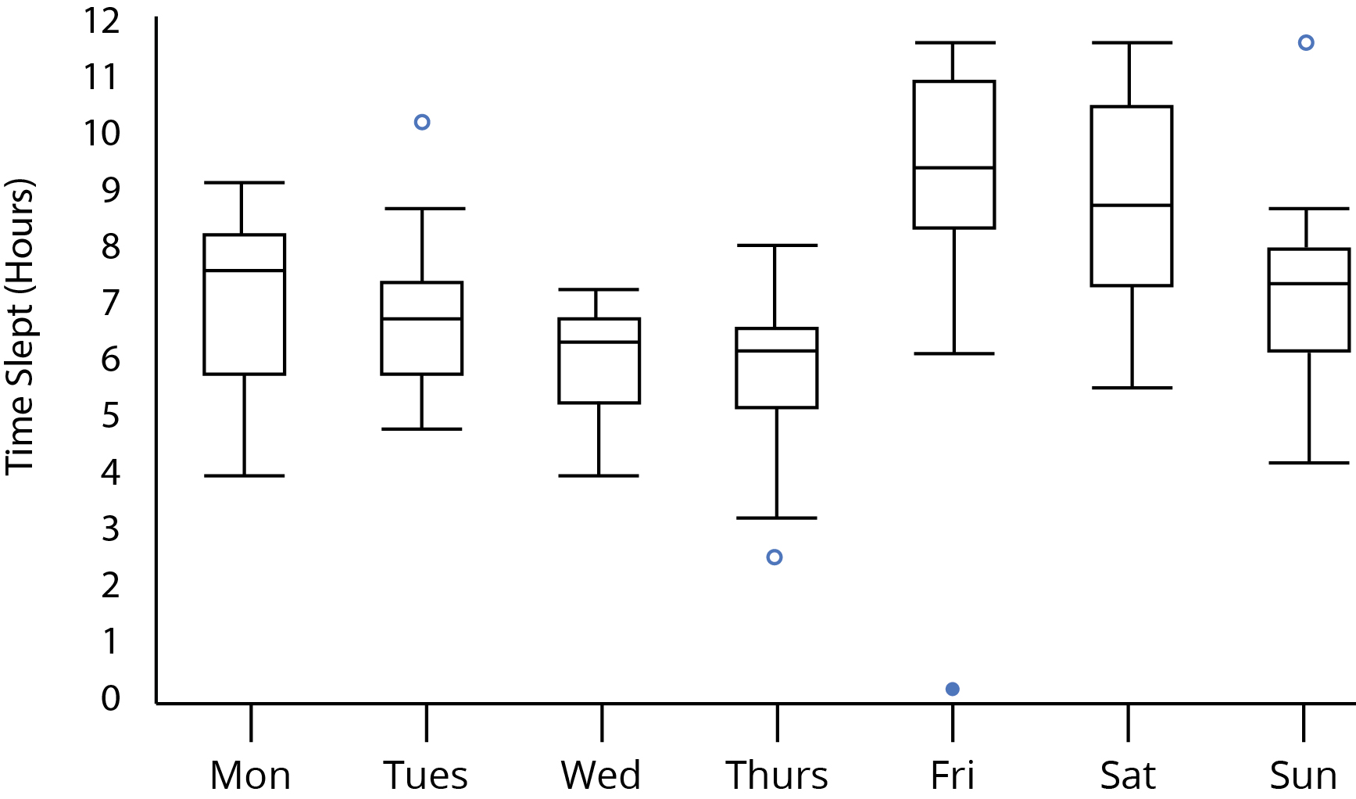
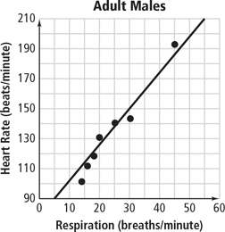
Stats in Geography:
Often similar to other disciplines
Notes:
Difference between descriptive and inferential statistics.
Example: rates of cancer in all state counties.

Slide 15
What’s distinctive about statistics in geography?
Notes:
Difference between descriptive and inferential statistics.
Example: rates of cancer in all state counties.

Slide 16
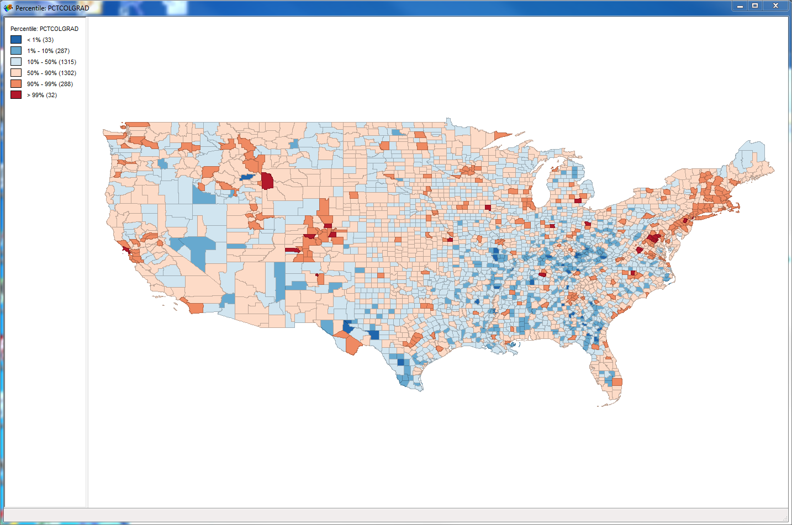
1. Methods
Spatial clustering
Spatial lag/influence
Space/time geography
Notes:
Difference between descriptive and inferential statistics.
Example: rates of cancer in all state counties.

Slide 17
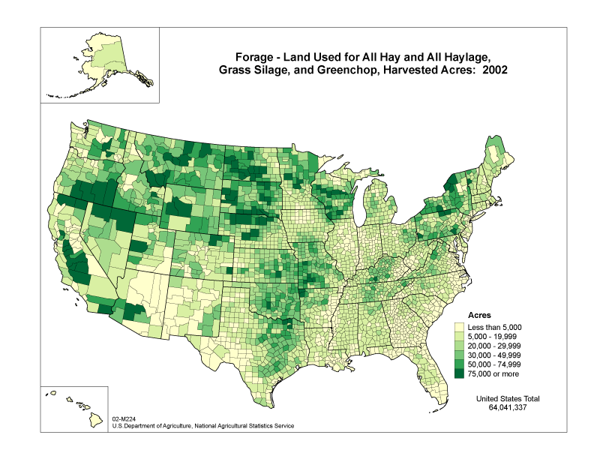
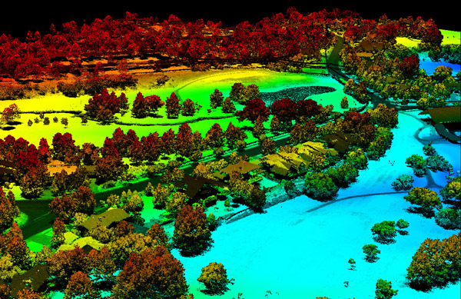
2. Sources of our data
3dgolfcourse.com
Notes:
What makes data geographic?
Wide variety of data sources and methods
Raster and vector based data sources
Information about a place in some form—often now through GIS based techniques

Slide 18


3. Unique disciplinary history

Slide 19
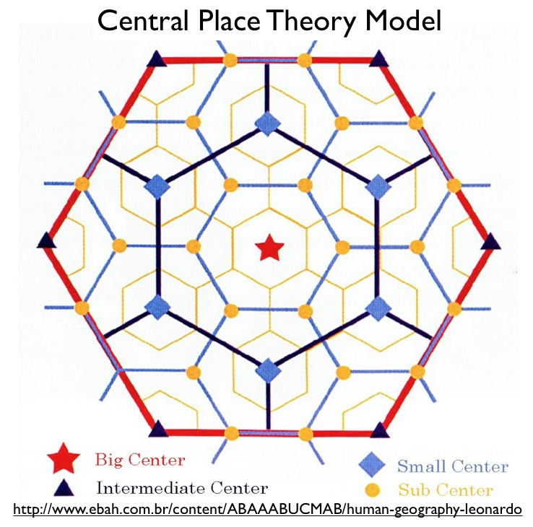
The quantitative revolution
Geocurrents.info
Notes:
Prior to the 1950s, geography was largely a descriptive science: cataloguing the attributes of particular places
Quantitative revolution started in response to widespread criticism of the discipline, closing of the Harvard Dept. in 1948
Move to find regular laws that governed spatial behavior
CENTRAL PLACE THEORY is one example or Thunen rings modeling land use
Seeking predictable patterns for how places develop

Slide 20
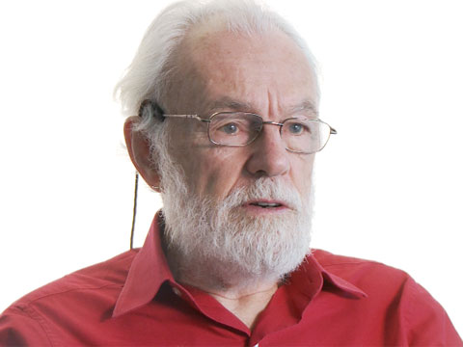
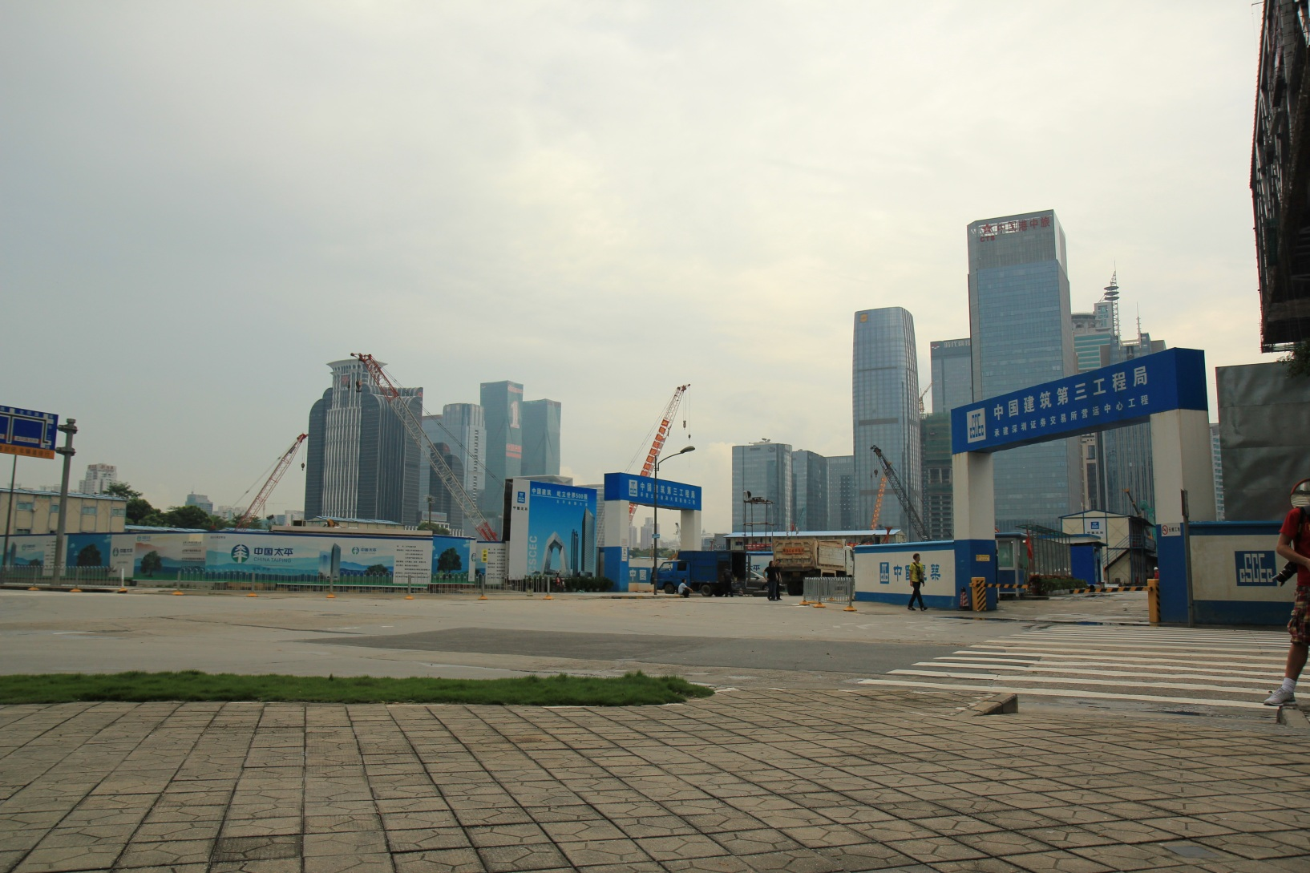
Tensions with critical human geography
http://uscaau.files.wordpress.com
The Guardian
Notes:
Critiques by critical geographers such as David Harvey, saying that these approaches treat as natural laws what are really social processes
Do cities develop this way naturally, or is this just how captialist cities work to produce profit? A need to question supposedly objective approaches for the politics at play.

Slide 21

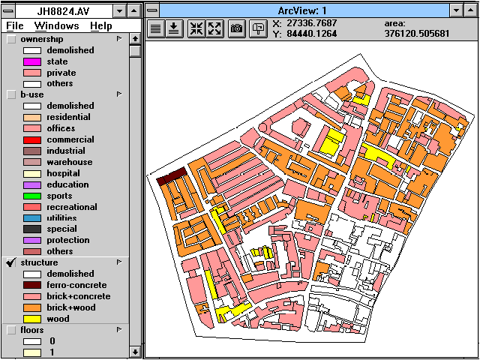
1960s and 1970s:
“Space cadets”
Notes:
Critiques by critical geographers such as David Harvey, saying that these approaches treat as natural laws what are really social processes
Do cities develop this way naturally, or is this just how captialist cities work to produce profit? A need to question supposedly objective approaches for the politics at play.

Slide 22
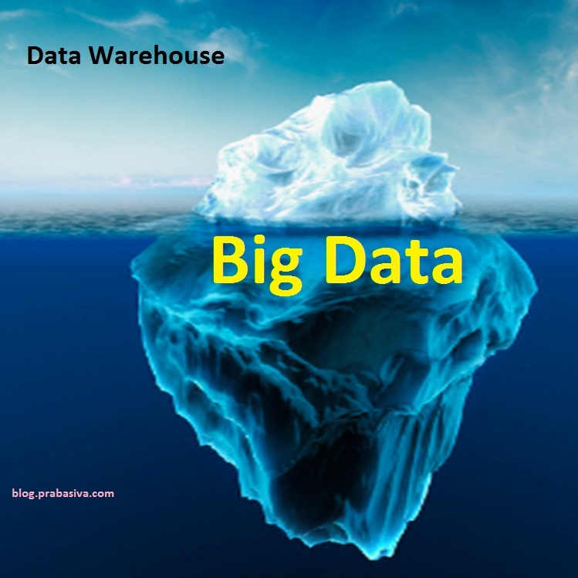
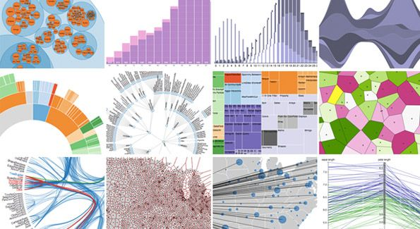
Notes:
More recently, new generation of work on quantitative geography drawing on increased computing power, GIS software, and increasing availability of “big data”
Methods for managing and analyzing datasets of multiple terabytes

Slide 23
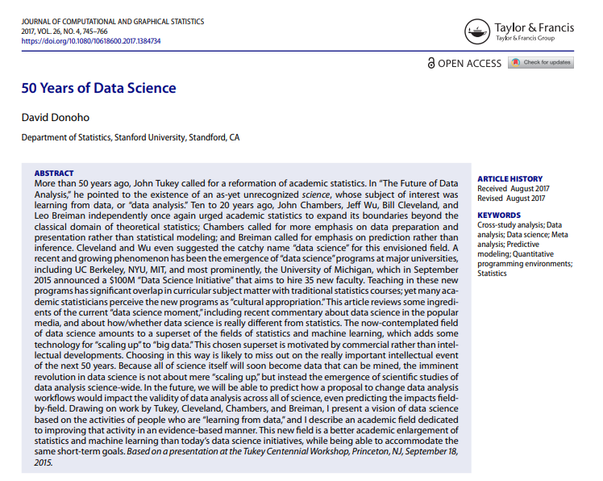
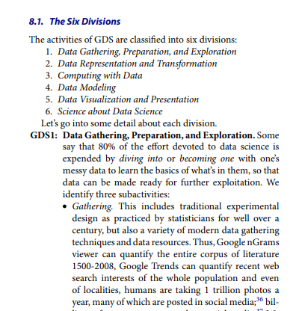
Notes:
Raster data
Comprised of raster cells—all the same size and all with a value
This data is always continuous and there are no discrete units—a single point or area.
Disclaimer: most of my work has been with vector based data
Common raster maps? Temperature data (interpolated), land cover, classified remote sensing imagery
Questions you could ask of a land cover map—what percentage of an area is covered by various land cover types. What’s the relationship between type of land cover and other characteristics: elevation, proximity to certain features, etc.?

Slide 24
“The recent explosion of data is not only a quantitative change in the amount of digital, machine‐readable information
at the fingertips of researchers and industry, it is also a profoundly qualitative change in how we think about, and work with, data. In this respect, Data Science is an already existing effort to make sense of, and synthesise the most appropriate ways to cope with, this ‘brave new world.’”
Notes:
Raster data
Comprised of raster cells—all the same size and all with a value
This data is always continuous and there are no discrete units—a single point or area.
Disclaimer: most of my work has been with vector based data
Common raster maps? Temperature data (interpolated), land cover, classified remote sensing imagery
Questions you could ask of a land cover map—what percentage of an area is covered by various land cover types. What’s the relationship between type of land cover and other characteristics: elevation, proximity to certain features, etc.?

Slide 25
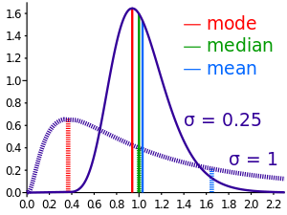
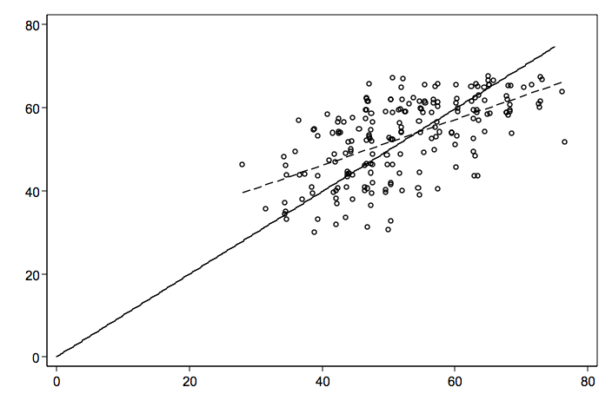
Types of statistics
Descriptive statistics: describes a data set.
Inferential statistics: makes generalizations from a sample group
Notes:
Difference between descriptive and inferential statistics.
Example: rates of cancer in all state counties.

Slide 26
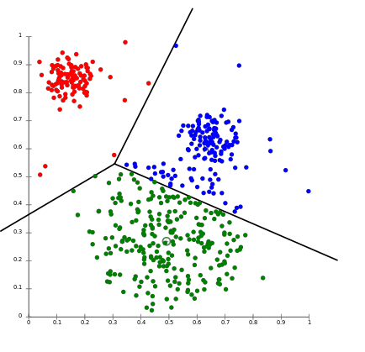
Types of statistics
Notes:
Raster data
Comprised of raster cells—all the same size and all with a value
This data is always continuous and there are no discrete units—a single point or area.
Disclaimer: most of my work has been with vector based data
Common raster maps? Temperature data (interpolated), land cover, classified remote sensing imagery
Questions you could ask of a land cover map—what percentage of an area is covered by various land cover types. What’s the relationship between type of land cover and other characteristics: elevation, proximity to certain features, etc.?

Slide 27
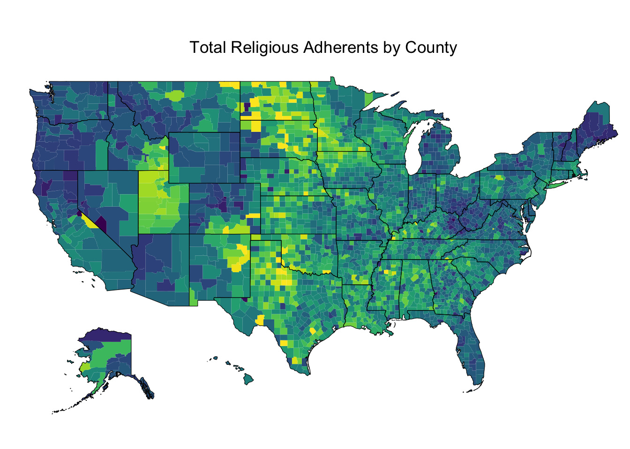
Descriptive statistics
Central tendency
Distribution
Change over time
Data visualization/exploratory analysis
Notes:
Raster data
Comprised of raster cells—all the same size and all with a value
This data is always continuous and there are no discrete units—a single point or area.
Disclaimer: most of my work has been with vector based data
Common raster maps? Temperature data (interpolated), land cover, classified remote sensing imagery
Questions you could ask of a land cover map—what percentage of an area is covered by various land cover types. What’s the relationship between type of land cover and other characteristics: elevation, proximity to certain features, etc.?

Slide 28
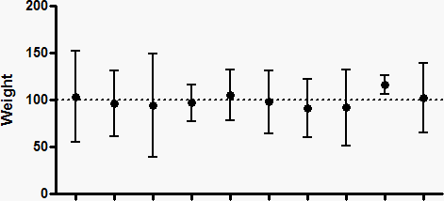
Inferential statistics
Difference in means/t-tests
Confidence intervals
Correlation
Regression
Notes:
Raster data
Comprised of raster cells—all the same size and all with a value
This data is always continuous and there are no discrete units—a single point or area.
Disclaimer: most of my work has been with vector based data
Common raster maps? Temperature data (interpolated), land cover, classified remote sensing imagery
Questions you could ask of a land cover map—what percentage of an area is covered by various land cover types. What’s the relationship between type of land cover and other characteristics: elevation, proximity to certain features, etc.?

Slide 29
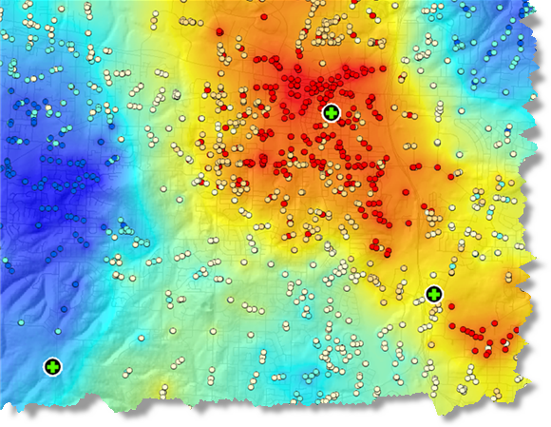
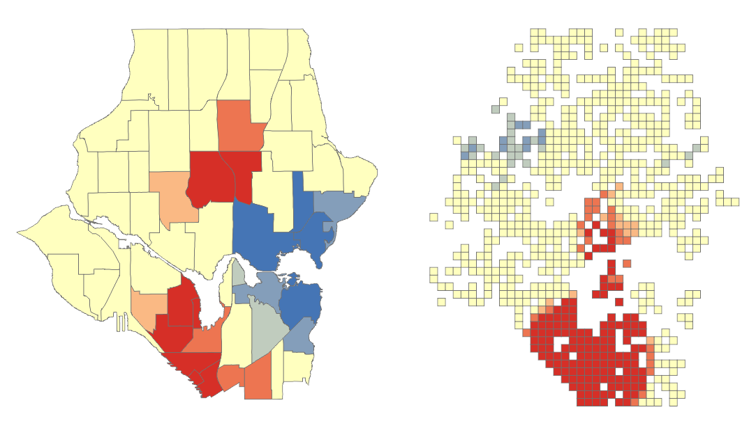
Spatial statistics
Spatial autocorrelation/Hotspot analysis
Spatial clustering
Geographic regression models
Notes:
Raster data
Comprised of raster cells—all the same size and all with a value
This data is always continuous and there are no discrete units—a single point or area.
Disclaimer: most of my work has been with vector based data
Common raster maps? Temperature data (interpolated), land cover, classified remote sensing imagery
Questions you could ask of a land cover map—what percentage of an area is covered by various land cover types. What’s the relationship between type of land cover and other characteristics: elevation, proximity to certain features, etc.?

Slide 30

Let’s talk about ungrading
Notes:
Raster data
Comprised of raster cells—all the same size and all with a value
This data is always continuous and there are no discrete units—a single point or area.
Disclaimer: most of my work has been with vector based data
Common raster maps? Temperature data (interpolated), land cover, classified remote sensing imagery
Questions you could ask of a land cover map—what percentage of an area is covered by various land cover types. What’s the relationship between type of land cover and other characteristics: elevation, proximity to certain features, etc.?

Slide 31

What is ungrading?
“The focus of ungrading is to provide extensive feedback to students and then jointly (students and instructors) come to a consensus as to what the grade should be.”
https://www.chemedx.org/blog/ungrading-what-it-and-why-should-we-use-it
Notes:
Raster data
Comprised of raster cells—all the same size and all with a value
This data is always continuous and there are no discrete units—a single point or area.
Disclaimer: most of my work has been with vector based data
Common raster maps? Temperature data (interpolated), land cover, classified remote sensing imagery
Questions you could ask of a land cover map—what percentage of an area is covered by various land cover types. What’s the relationship between type of land cover and other characteristics: elevation, proximity to certain features, etc.?

Slide 32
In this course:
Feedback with a general rating, but not tied to a grade
Student goal setting and self-evaluation
A focus on collaborative work and self-motivated learning
Notes:
Raster data
Comprised of raster cells—all the same size and all with a value
This data is always continuous and there are no discrete units—a single point or area.
Disclaimer: most of my work has been with vector based data
Common raster maps? Temperature data (interpolated), land cover, classified remote sensing imagery
Questions you could ask of a land cover map—what percentage of an area is covered by various land cover types. What’s the relationship between type of land cover and other characteristics: elevation, proximity to certain features, etc.?

Slide 33
What are my goals for you?
Improve confidence in using quantitative techniques
Be able to interpret and constructively critique others’ statistical research
Learn common workflows for exploratory data analysis and data science
Be able to explain common techniques for quantitative and spatial analysis and decide which is relevant to a given research problem
Gain expertise in using R as an open-source programming platform for quantitative analysis
Attend class regularly and be an active participant (but also keep us safe)
Contribute to and benefit from our collective learning
Notes:
Raster data
Comprised of raster cells—all the same size and all with a value
This data is always continuous and there are no discrete units—a single point or area.
Disclaimer: most of my work has been with vector based data
Common raster maps? Temperature data (interpolated), land cover, classified remote sensing imagery
Questions you could ask of a land cover map—what percentage of an area is covered by various land cover types. What’s the relationship between type of land cover and other characteristics: elevation, proximity to certain features, etc.?

Slide 34
What does an “A” look like for you?
Do NOT use good grades, but focus on what those grades would show about you. For example, you could finish one or more of the following statements:
“I would understand how…”
“I would be able to…”
“I would learn…”
“I could explain…”
Notes:
Raster data
Comprised of raster cells—all the same size and all with a value
This data is always continuous and there are no discrete units—a single point or area.
Disclaimer: most of my work has been with vector based data
Common raster maps? Temperature data (interpolated), land cover, classified remote sensing imagery
Questions you could ask of a land cover map—what percentage of an area is covered by various land cover types. What’s the relationship between type of land cover and other characteristics: elevation, proximity to certain features, etc.?

Slide 35
What does an “A” look like for you?
Post your goals on ELC by Thursday’s classtime. We’ll be reflecting back on these throughout the course.
Notes:
Raster data
Comprised of raster cells—all the same size and all with a value
This data is always continuous and there are no discrete units—a single point or area.
Disclaimer: most of my work has been with vector based data
Common raster maps? Temperature data (interpolated), land cover, classified remote sensing imagery
Questions you could ask of a land cover map—what percentage of an area is covered by various land cover types. What’s the relationship between type of land cover and other characteristics: elevation, proximity to certain features, etc.?

Slide 36
Getting started with R!
Install R/Rstudio/Git
Clone the course repository (“repo”)
Get started using data in R: Script S01-1
Notes:
Raster data
Comprised of raster cells—all the same size and all with a value
This data is always continuous and there are no discrete units—a single point or area.
Disclaimer: most of my work has been with vector based data
Common raster maps? Temperature data (interpolated), land cover, classified remote sensing imagery
Questions you could ask of a land cover map—what percentage of an area is covered by various land cover types. What’s the relationship between type of land cover and other characteristics: elevation, proximity to certain features, etc.?

